Slide 1

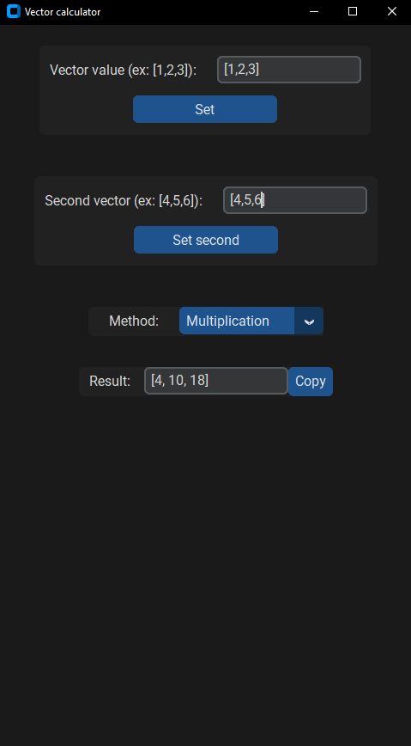

Vector Calculator
Turdalin Nurassyl 20B030619

Slide 2
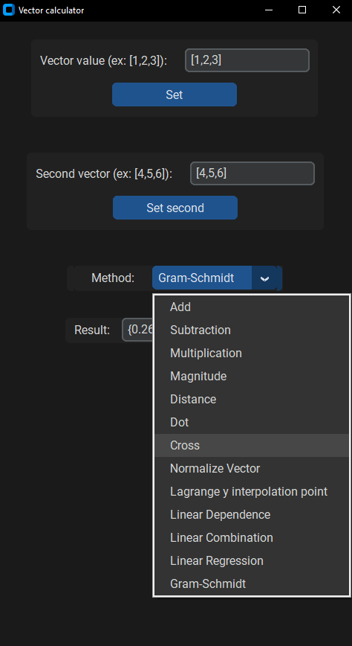
I'm not a mathematician
THAT’S WHY I PICKED VECTORS CALCULATOR, BUT EVEN SO, I TRIED MY BEST TO NOT USE READY LIBRARIES
Methods (basic and algorithmic):
Add, Multiply, Subtraction, Scalar multiplication
Magnitude of vector
Dot, Cross products of two vectors
Euclidean distance between two vectors
Vector normalization
Method to find Lagrange Interpolation
Method to find Linear Dependence
Method to find Linear Combination
Linear Regression Method using Least Square Method to find curve of best fit of type y=a+bx
Gram-Schmidt method

Slide 3
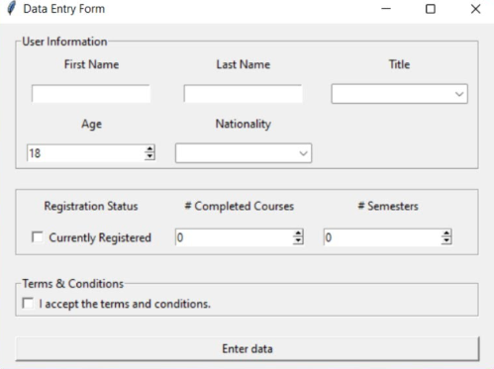
Tkinter ugly?
Functionality is important, but look is not less important. We know that tkinter is very ugly by default. And I couldn’t work with this further. So, there was another option. And it call CustomTkinter.

Slide 4
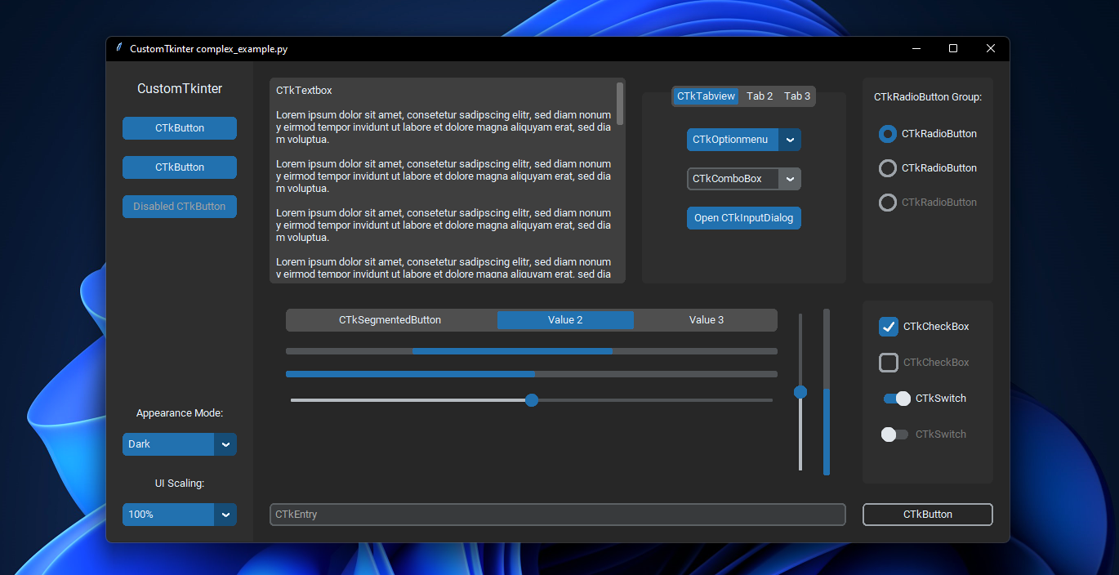
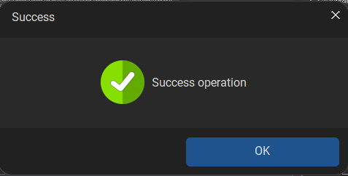
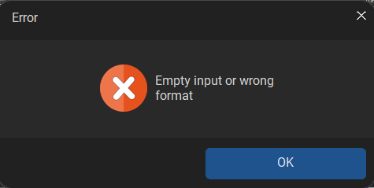
CustomTkinter
It’s same Tkinter, but just prettier. So, it was obvious that I will use this library. Also, there is one more library for custom tkinter, which is for messageboxes.

Slide 5
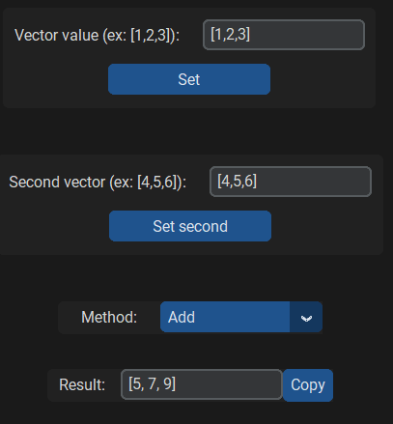
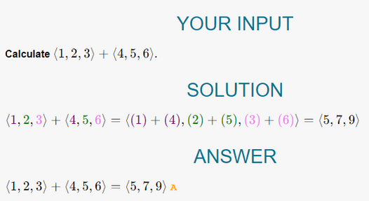
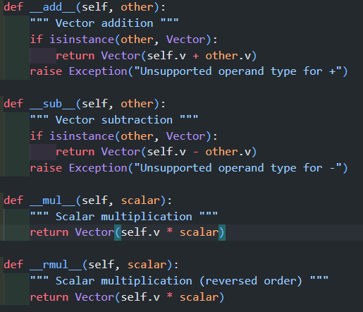
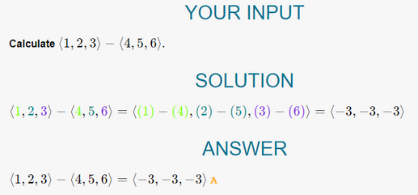
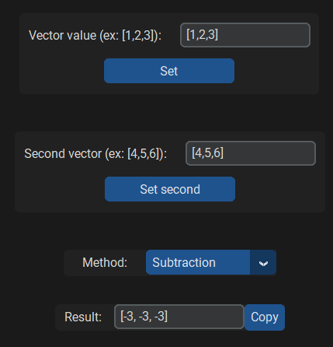
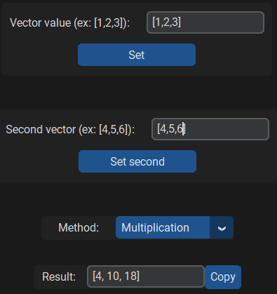
Basic operations
The easiest part of calculator. We can do this with simple logic

Slide 6
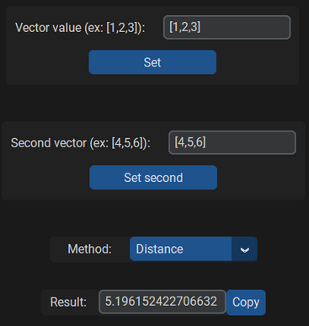
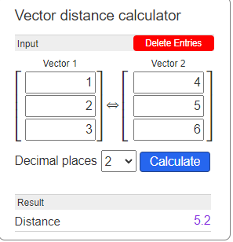
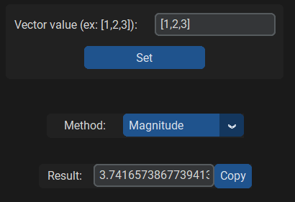
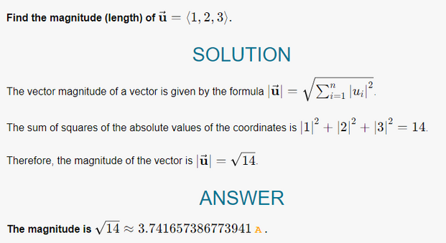

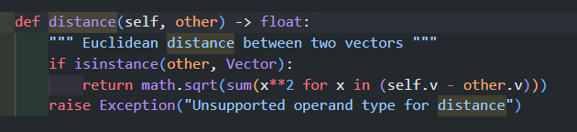
DISTANCE
MAGNITUDE
There are multiple ways to find distance. In my case, i subtracted vectors from each other, then getting norm of it, will give us distance.
It’s just norm from origin vector. So we will get magnitude of vector.

Slide 7
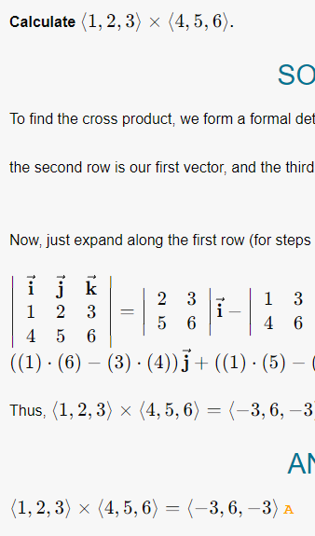
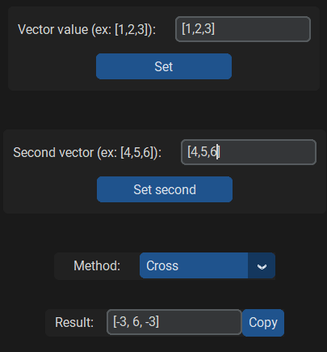
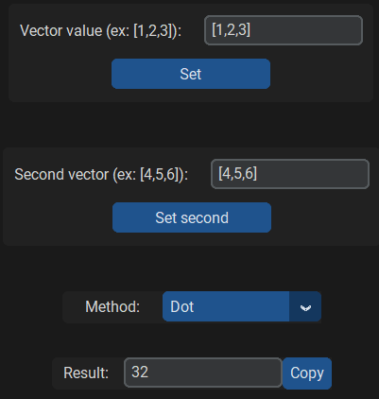
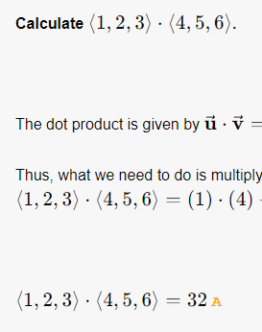
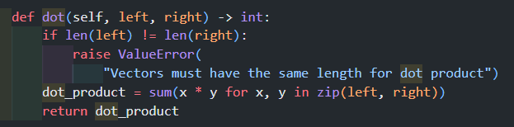
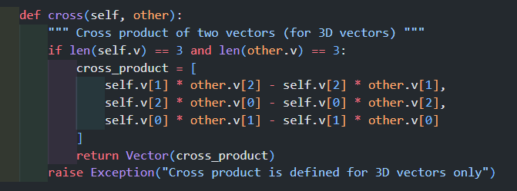
CROSS
DOT

Slide 8
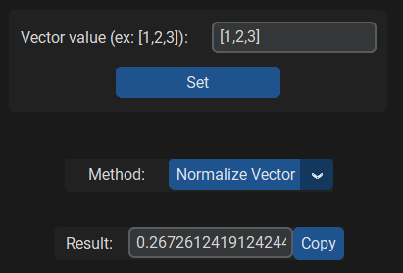
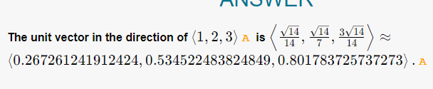
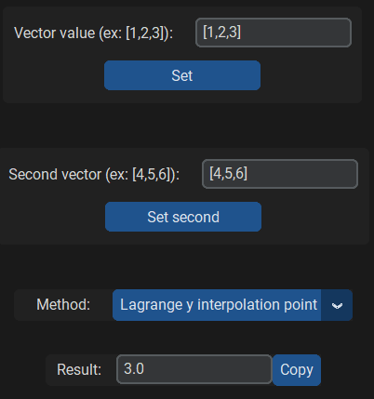
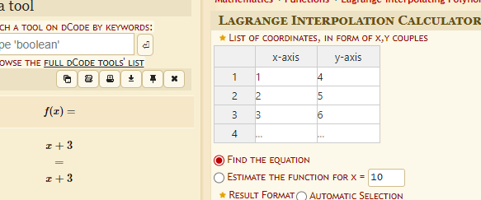
BASIC+ METHODS
Normalization
ak unit vector
[0.267, 0.534, 0.801]
Lagrange Interpolation
My method does not return full polynom, xp is interpolation point given by user and output of Lagrange interpolation method is obtained in yp.

Slide 9
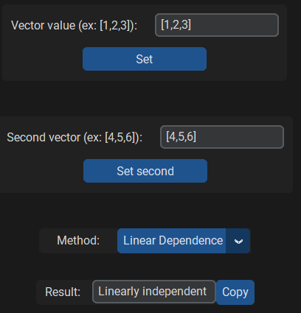
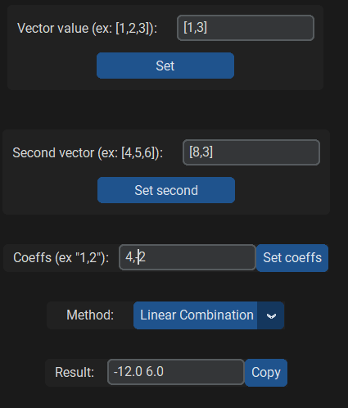
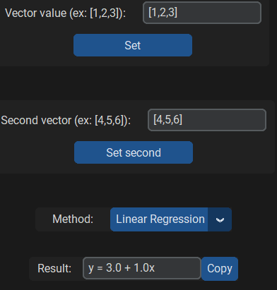
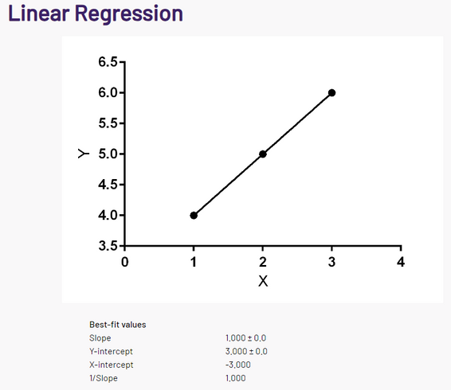
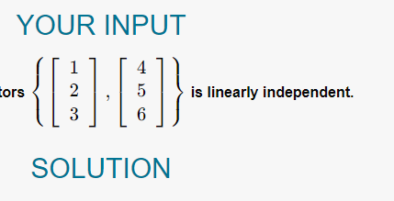

Linearness
REGRESSION
DEPENDENCE
COMBINATION
Linear Regression Method using Least Square Method to find curve of best fit of type y=a+bx

Slide 10
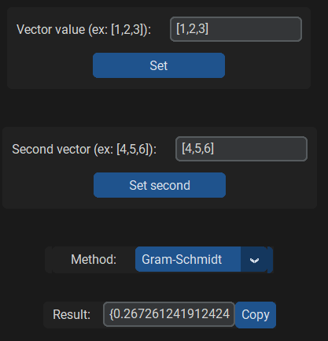
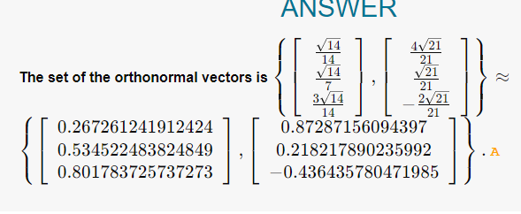
GRAM-SCHMIDT
ak orthonormal basis
{0.267 0.534 0.801}
{0.872 0.218 -0.436}

Slide 11
THANK YOU!

